Slide 1

Medford Township
Capital & Debt Service Presentation

Slide 2

How does Medford Township finance its Capital and manage its overall Debt Service for the Town?
Bond Anticipation Note (BAN)
Considered Short Term Debt
Usually matures in 1 year or less, can roll for three years with only paying interest only payments annually. By the fourth year if you continue to roll it, State law requires principal payments to be made in addition to interest payments.
Used to provide interim financing until permanent bonds can be issued.
Interest rates are generally lower because of the short maturity, however cost of reissuing the BAN is added annually.
Permanently Finance BOND
Considered Long Term Debt
Typically matures over 10 to 30 years and is used to provide long-term financing for capital projects.
Interest rates are fixed for the term and are generally higher than a BAN, however cost of issuing the BOND is once verse annually with a BAN.
BONDs are viewed as more stable financing because municipalities can plan future budgets with set debt service numbers.

Slide 3
How does Medford Township fund its overall Debt Service for the Town?
General Improvement/General Capital Debt Service is funded from three separate Township Budgets
    Current Fund
    Open Space Fund
    Water and Sewer Fund

Slide 4
Current Fund Debt Service
Permanently Financed BONDs

Slide 5
Current Fund Debt Service
Permanently Financed BONDs & BAN
*5 years of Capital remains in BANs due to prior Management not allowing to Permanently Finance Debt on a rolling 2 to 3 year period.

Slide 6
Current Fund Debt Service
Permanently Financed BONDs & BAN
*Impact of 2026’s Capital Ordinance

Slide 7
Factors Affecting Current Fund Debt Service
Debt Financing: The last time Medford permanently financed its BAN debt was in 2022, under prior management’s direction, despite the Township’s historical practice of rolling BANs for no more than three years.
Ladder Truck Financing: In 2025, the Township prepaid $2,128,356.83 for a Fire Department ladder truck not scheduled for delivery until 2028, receiving a reported savings of $250,385.81. However, this prepayment is not permitted under NJ Public Contracts Law. Had the funds remained invested at approximately 3.3%, the interest earned in our bank accounts would have exceeded the savings yielded. Conversely what the Township did was defer borrowing the funds to support such purchase, while using Capital fund balance reserves to float the payment. This reduced Capital fund balance reserves, causing a reduction in fund to gain interest on. Therefore, if the decision was to prepay for this truck, then the funds should have come from a permanently financed bond, instead of depleting Capital fund balance reserves. The other course of action the Township could have made would be to deferred payment, along with deferring permeant financing until the truck was delivered and gained more interest in the Capital fund balances reserves, which would have been greater than saving yield from the prepayment.
Historical Debt Costs: Debt expenditures in the Current Fund budget have remained consistent annually: $3,326,746 in 2023; $3,521,460 in 2024; $3,547,527 in 2025; and $3,300,312 in 2026.
Ordinance 2026-13: The recently passed $2,938,000 ordinance includes $1,200,000 for road improvements. Because the Township is approximately one to two years behind schedule on these projects, that portion is not expected to be funded until 2027, when the Township plans to permanently finance the outstanding BANs.
Current Plan: The Township’s current plan is to roll the remaining capital BANs into one permanent bond next year and permanently finance all currently adopted ordinances. The projected impact on the average taxpayer is approximately $55 over the next three years.

Slide 8
Open Space Fund Debt Service
Permanently Financed BONDs

Slide 9
Open Space Fund Debt Service
Permanently Financed BONDs & BAN
*One Capital Item remains in BANs since 2025 when it was enacted by Ordinance, the project is for a DEK Hockey Rink for a total Capital amount of $655,690.

Slide 10
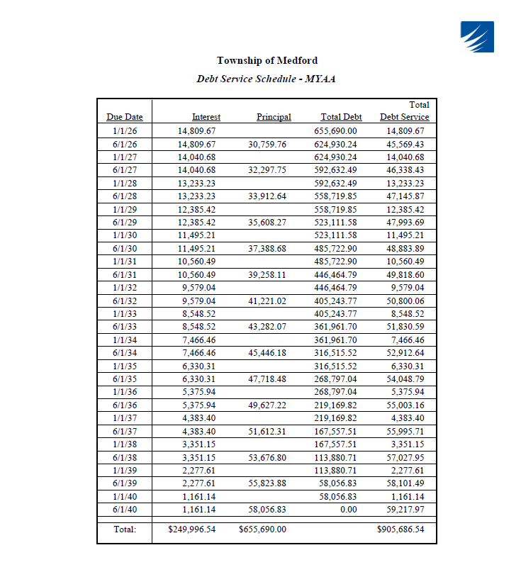
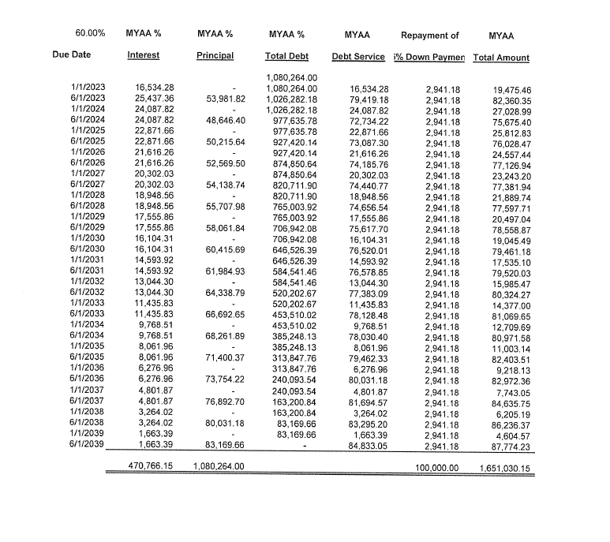
Financial Support from MYAA for
Open Space Fund Debt
MYAA Turf Field Repayment Schedule based at 60% of Total Debt
Dek Hockey Payment Schedule

Slide 11
Factors Affecting Open Space Fund Debt Service
Debt Financing: The last time Medford permanently financed its BAN debt was in 2022, under prior management’s direction, despite the Township’s historical practice of rolling BANs for no more than three years.
Dek Hockey Rink: The only ordinance added to this fund since the last bond issuance is for the Dek Hockey Rink. The Township has an agreement with MYAA to cover the full cost of this expense. Although a payment schedule was established with MYAA, the debt has not yet been permanently financed. Additionally, the prior manager placed MYAA’s 2026 payment for this project into the Current Fund budget rather than the Open Space Fund as required under the agreement. The agreement remains in effect through 2040.
Cow Pointe Preservation Debt: More than half of the Township’s permanent debt service in this fund is attributable to the preservation of Cow Pointe. This debt is scheduled to be fully paid off in 2033.
Turf Field Debt Service: MYAA also has an agreement with the Township to fund 60% of the annual debt service associated with the Township’s turf fields through 2039. In 2026, MYAA’s contribution to this fund for debt service is $101,684.38. Contributions are projected to be $100,625.14 in 2027, $99,487.45 in 2028, and $99,055.91 in 2029.
Historical Debt Costs: Overall debt expenditures in the Open Space Fund budget have been $878,222 in 2023, $890,327 in 2024, $882,502 in 2025, and $833,757 in 2026.
Current Plan: The current plan is to roll the capital BAN into next year and then permanently finance the Dek Hockey Rink debt. The projected impact of this financing is expected to be fully offset by MYAA’s reimbursement under the existing agreement.

Slide 12
Water & Sewer Fund Debt Service
Permanently Financed BONDs & BAN
*5 years of Capital remains in BANs due to prior Management not allowing to Permanently Finance Debt on a rolling 2 to 3 year period.

Slide 13
Water & Sewer Debt Service
Permanently Financed BONDs & BAN
*Impact of 2026’s Capital Ordinance

Slide 14
Factors Affecting Water & Sewer Fund Debt Service
Debt Financing: The last time Medford permanently financed its BAN debt was in 2022, under prior management’s direction, despite the Township’s historical practice of rolling BANs for no more than three years.
Total Debt Currently funded through BANs: Currently the Water and Sewer Fund has $6,798,278 of debt funded through BANs which is short term financing which should have been capitalized in 2025, to provide long term stability.
Historical Debt Costs: Debt expenditures in the Current Fund budget have remained consistent annually: $2,649,029 in 2023; $2,837,639 in 2024; $2,926,382 in 2025; and $2,710,180 in 2026.
Ordinance 2026-14: The recently passed $4,875,000 ordinance includes $4,550,000 million for projects that include improvements to the sewer plant consisting of replacing the grinder, sludge pumps and RBC Bearings, in addition to slip lining of sewer lines. Improvements to the water system will include rehabilitation of Wells 3, 6, 14, 15, 16, and 17, replacement of lead service lines, replacement of water meters and continuing to upgrade water service mains in streets with corresponding road improvements. Because the Township is approximately one year behind schedule with existing projects, parts of this portion are not expected to be funded until 2027, when the Township plans to permanently finance the outstanding BANs.
Current Plan: The Township’s current plan is to roll the remaining capital BANs into one permanent bond next year and permanently finance all currently adopted ordinances. The projected impact to current annual debt payments will be an additional $86,399 in 2027 and $100,135 in 2028 before debt service rapidly decreases allowing for flexibility in funding future projects.

